Slide 1
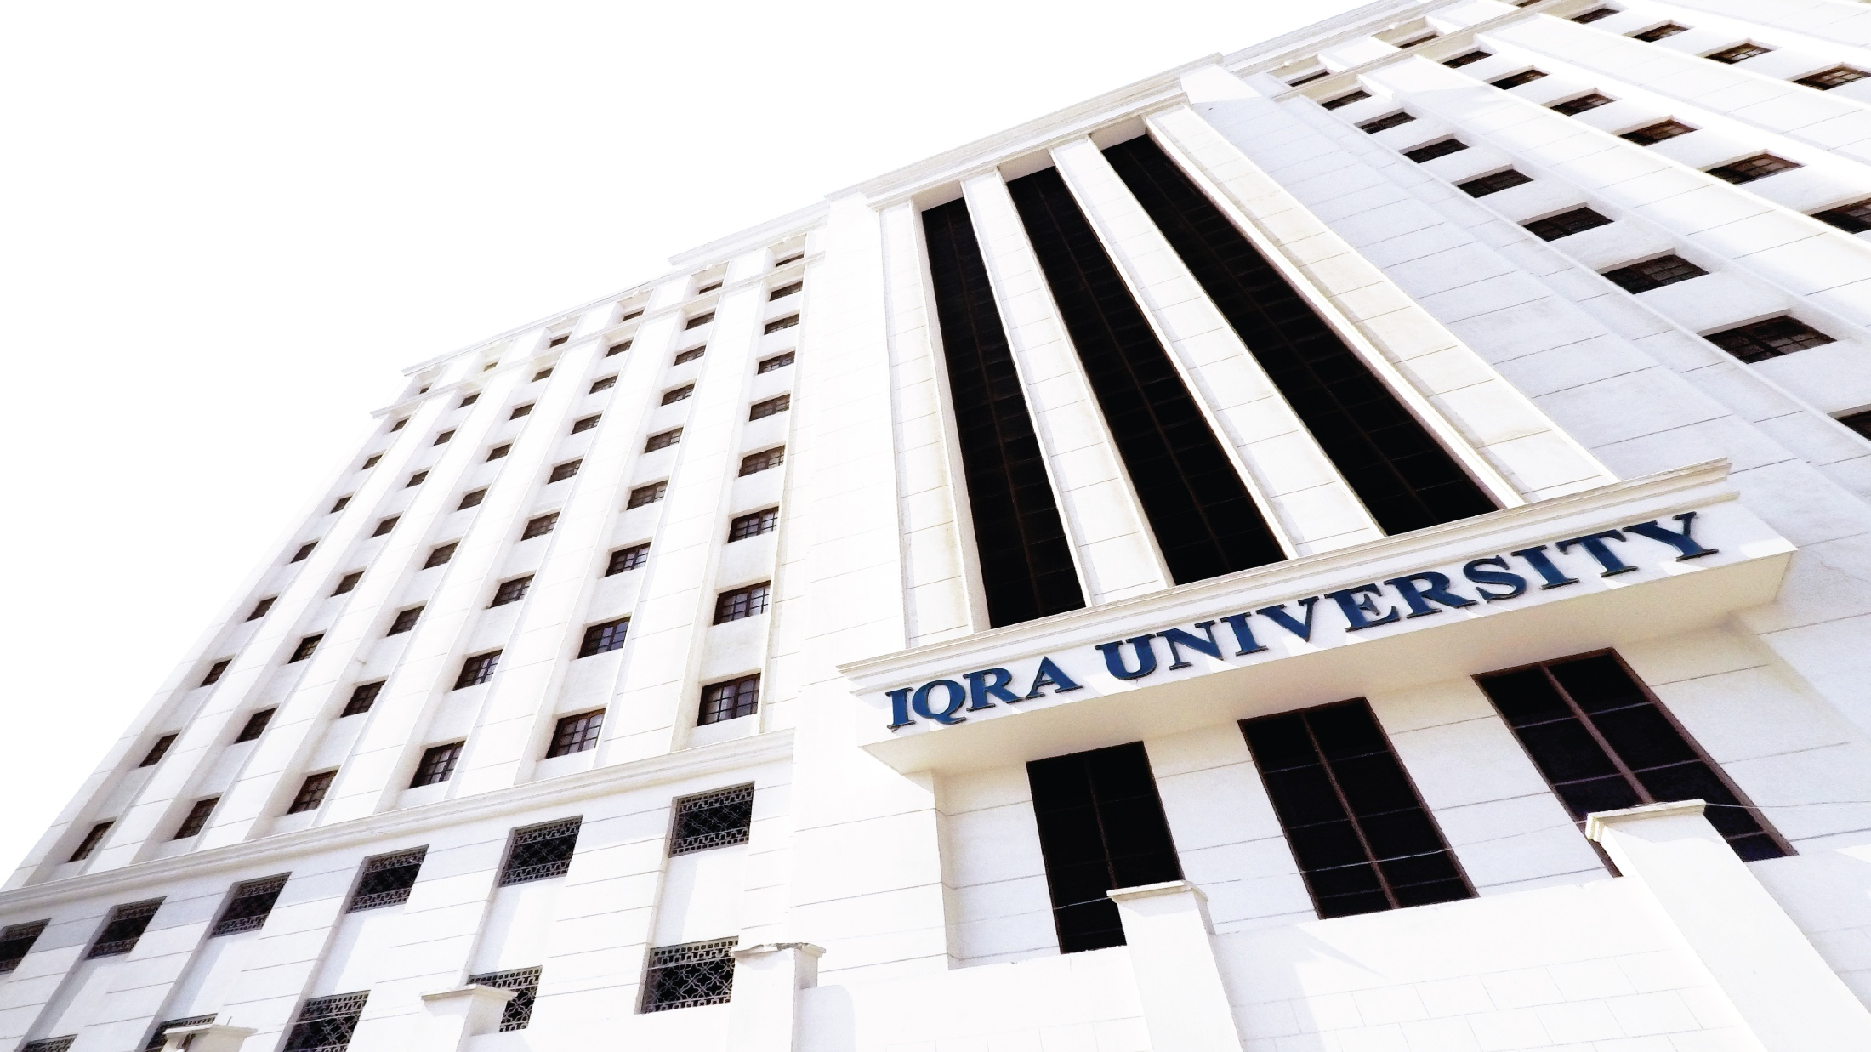

William Stallings Computer Organization and Architecture 8th Edition
Chapter 3
Cont. Top Level View of Computer Function
and Interconnection
Book by : Computer, Architecture and Organizations, 8th Edition ,William Stalling
Original Slides by : Adrian J Pullin

Slide 2
Top Level View of Computer
Function and Interconnection

Slide 3
Lecture Outcomes
Understanding of:
Time Sequence
Computer Modules
Computer Interconnection
Bus Structure
Bus Arbitration
PCI

Slide 4
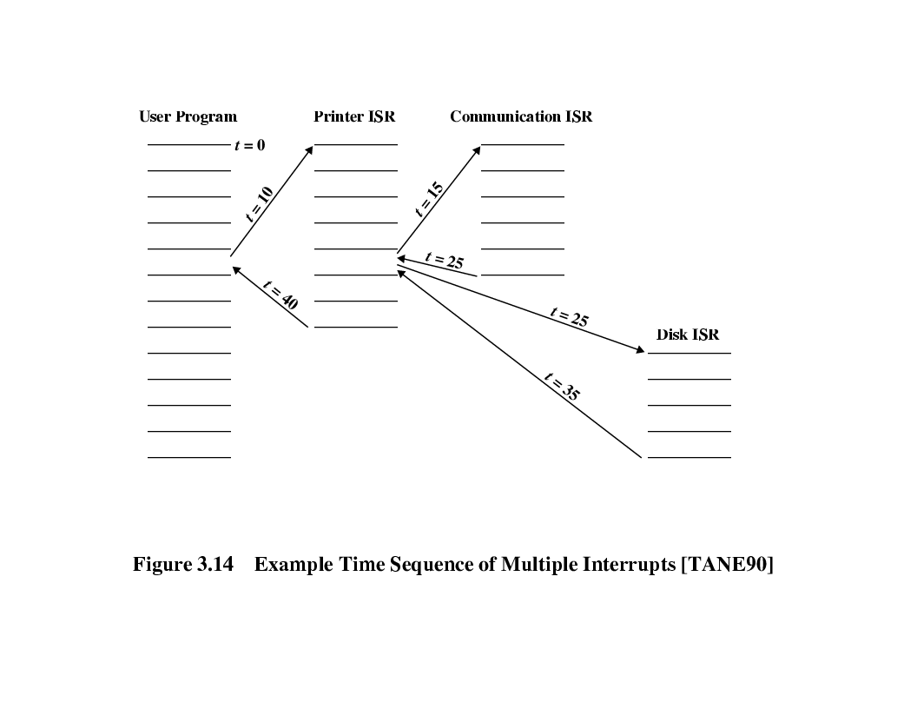
Time Sequence of Multiple Interrupts

Slide 5
Connecting
All the units must be connected
Different type of connection for different type of unit
Memory
Input/Output
CPU

Slide 6
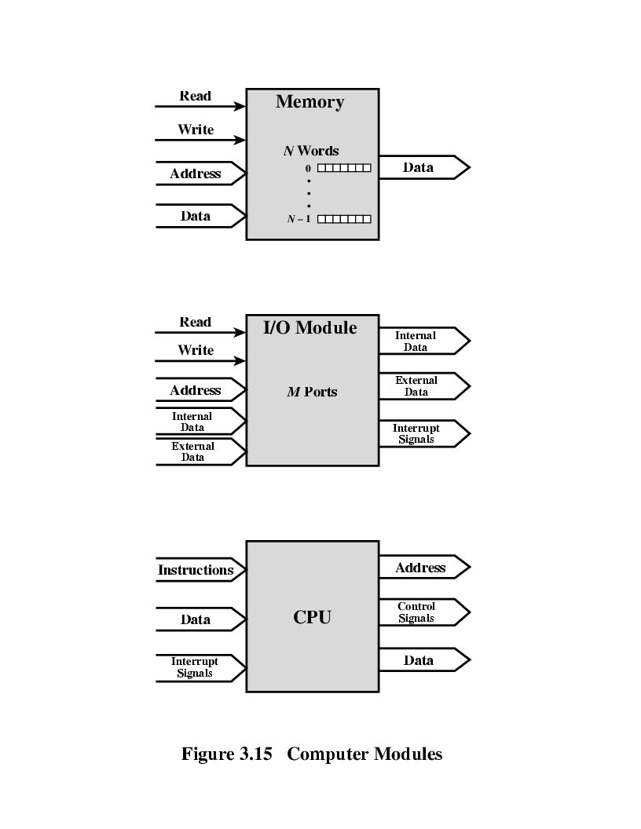
Computer Modules

Slide 7
Memory Connection
Receives and sends data
Receives addresses (of locations)
Receives control signals
Read
Write
Timing

Slide 8
Input / Output Connection(1)
Similar to memory from computer’s viewpoint
Output
Receive data from computer
Send data to peripheral
Input
Receive data from peripheral
Send data to computer

Slide 9
Input/Output Connection(2)
Receive control signals from computer
Send control signals to peripherals
e.g. spin disk
Receive addresses from computer
e.g. port number to identify peripheral
Send interrupt signals (control)

Slide 10
CPU Connection
Reads instruction and data
Writes out data (after processing)
Sends control signals to other units
Receives (& acts on) interrupts

Slide 11
Buses
There are a number of possible interconnection systems
Single and multiple BUS structures are most common
e.g. Control/Address/Data bus (PC)

Slide 12
What is a Bus?
A communication pathway connecting two or more devices
Usually broadcast
Often grouped
A number of channels in one bus
e.g. 32 bit data bus is 32 separate single bit channels
Power lines may not be shown

Slide 13
Data Bus
Carries data
Remember that there is no difference between “data” and “instruction” at this level
Width is a key determinant of performance
8, 16, 32, 64 bit

Slide 14
Address bus
Identify the source or destination of data
e.g. CPU needs to read an instruction (data) from a given location in memory
Bus width determines maximum memory capacity of system
e.g. 8080 has 16 bit address bus giving 64k address space

Slide 15
Control Bus
Control and timing information
Memory read/write signal
Interrupt request
Clock signals

Slide 16
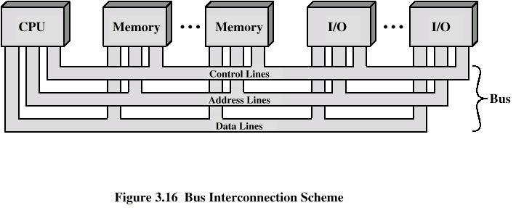
Bus Interconnection Scheme

Slide 17
Big and Yellow?
What do buses look like?
Parallel lines on circuit boards
Ribbon cables
Strip connectors on mother boards
e.g. PCI
Sets of wires

Slide 18
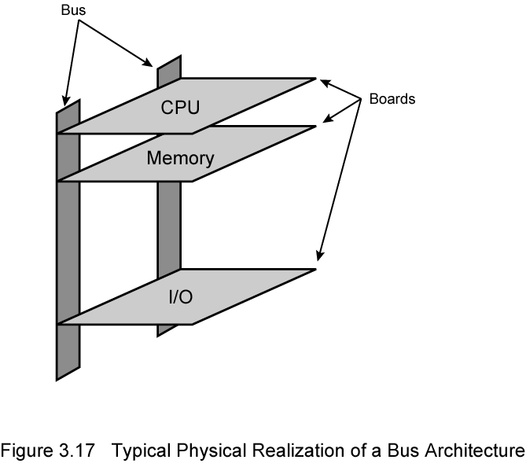
Physical Realization of Bus Architecture

Slide 19
Single Bus Problems
Lots of devices on one bus leads to:
Propagation delays
Long data paths mean that co-ordination of bus use can adversely affect performance
If aggregate data transfer approaches bus capacity
Most systems use multiple buses to overcome these problems

Slide 20
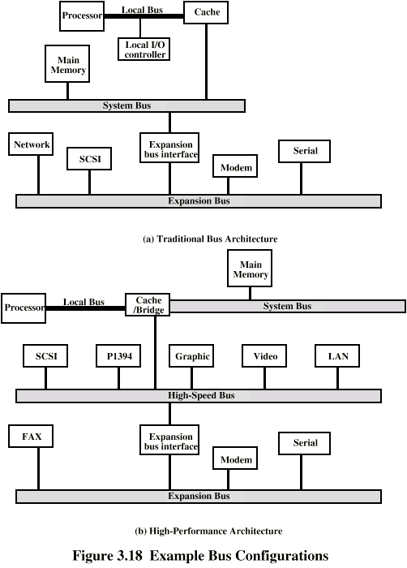
Traditional (ISA) (with cache)

Slide 21
High Performance Bus

Slide 22
Bus Types
Dedicated
Separate data & address lines
Multiplexed
Shared lines
Address valid or data valid control line
Advantage - fewer lines
Disadvantages
More complex control
Ultimate performance

Slide 23
Bus Arbitration
More than one module controlling the bus
e.g. CPU and DMA controller
Only one module may control bus at one time
Arbitration may be centralised or distributed

Slide 24
Centralised or Distributed Arbitration
Centralised
Single hardware device controlling bus access
Bus Controller
Arbiter
May be part of CPU or separate
Distributed
Each module may claim the bus
Control logic on all modules

Slide 25
PCI Bus
Peripheral Component Interconnection
Intel released to public domain
32 or 64 bit
50 lines

Slide 26
PCI Bus Lines (required)
Systems lines
Including clock and reset
Address & Data
32 time mux lines for address/data
Interrupt & validate lines
Interface Control
Arbitration
Not shared
Direct connection to PCI bus arbiter
Error lines

Slide 27
PCI Bus Lines (Optional)
Interrupt lines
Not shared
Cache support
64-bit Bus Extension
Additional 32 lines
Time multiplexed
2 lines to enable devices to agree to use 64-bit transfer
JTAG/Boundary Scan
For testing procedures

Slide 28
PCI Commands
Transaction between initiator (master) and target
Master claims bus
Determine type of transaction
e.g. I/O read/write
Address phase
One or more data phases

Slide 29
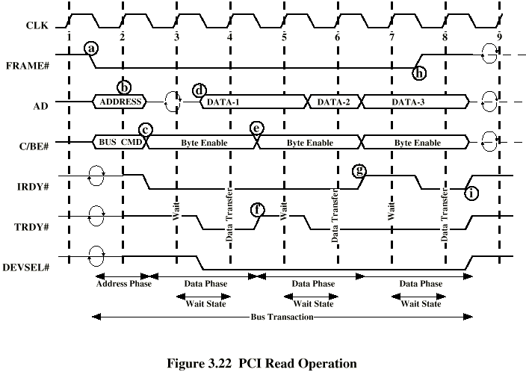
PCI Read Timing Diagram

Slide 30
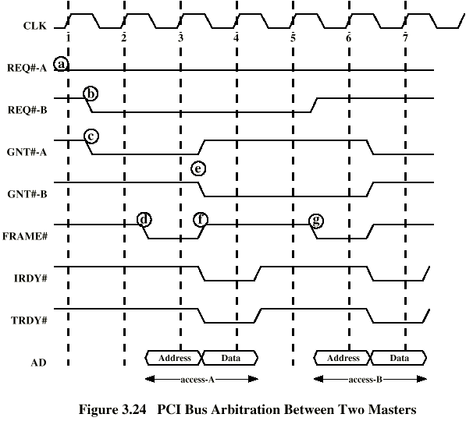
PCI Bus Arbitration

Slide 31
Review Questions
What is the benefit of using a multiple-bus architecture compared to a single-bus architecture?
List and briefly define the functional groups of signal lines for PCI.

Slide 32
Thank you

